Slide 1
Variations in stage design of August: Osage County
A presentation by Joseph Daly

Slide 2
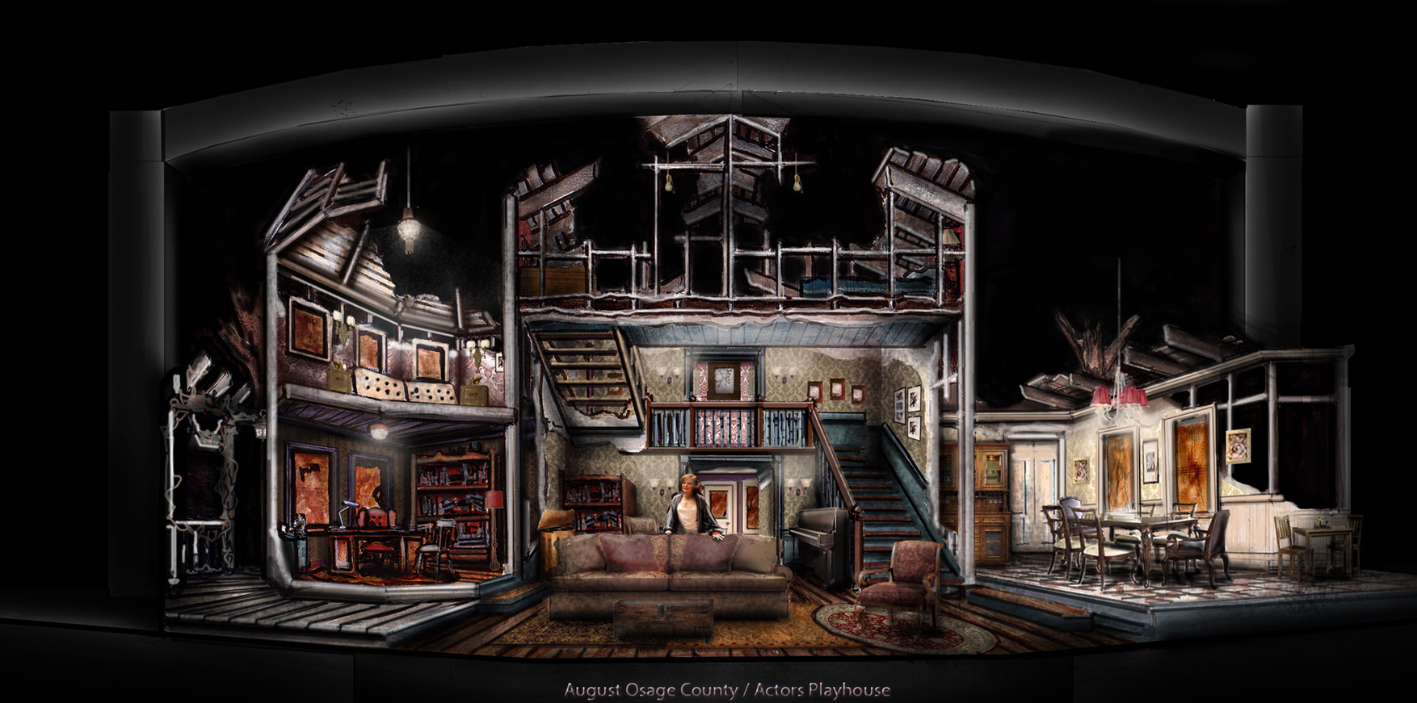
Introduction
Challenges in production
Variations of stage design
Compare/contrast stage design to similar plays
A concept design by Sean McClelland

Slide 3
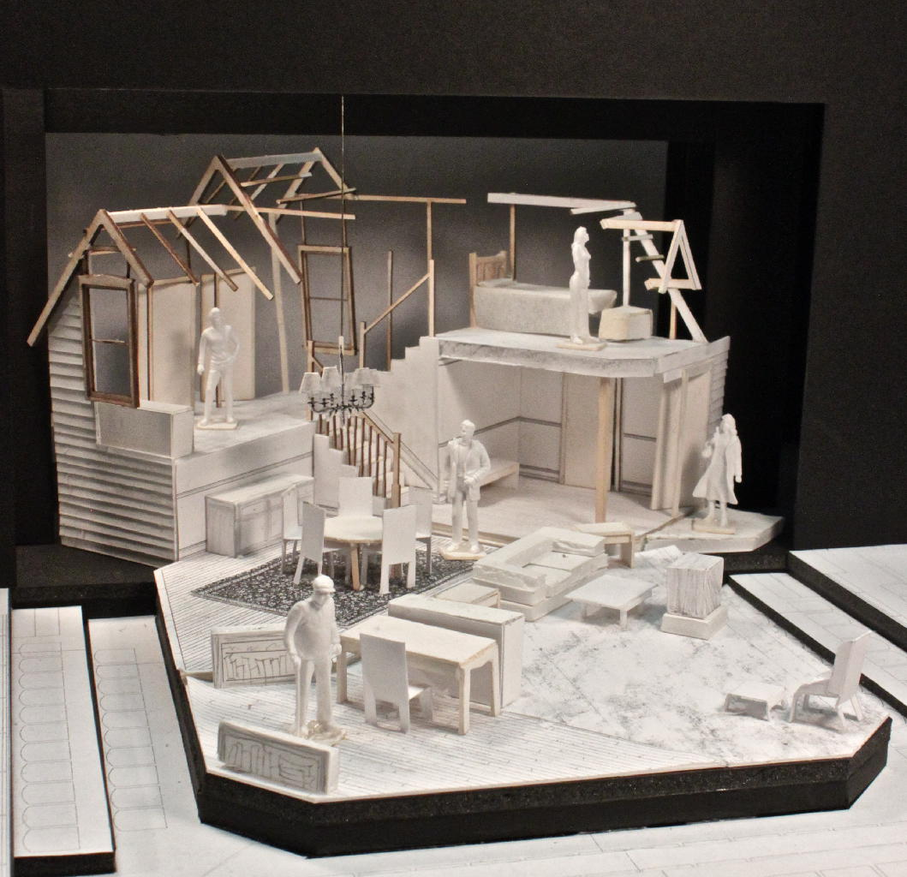
Challenges In Production
A non choppy set design
Physical limitations of the theater
Easily viewed by audience
Concept design for the Arthur Miller Theater production

Slide 4
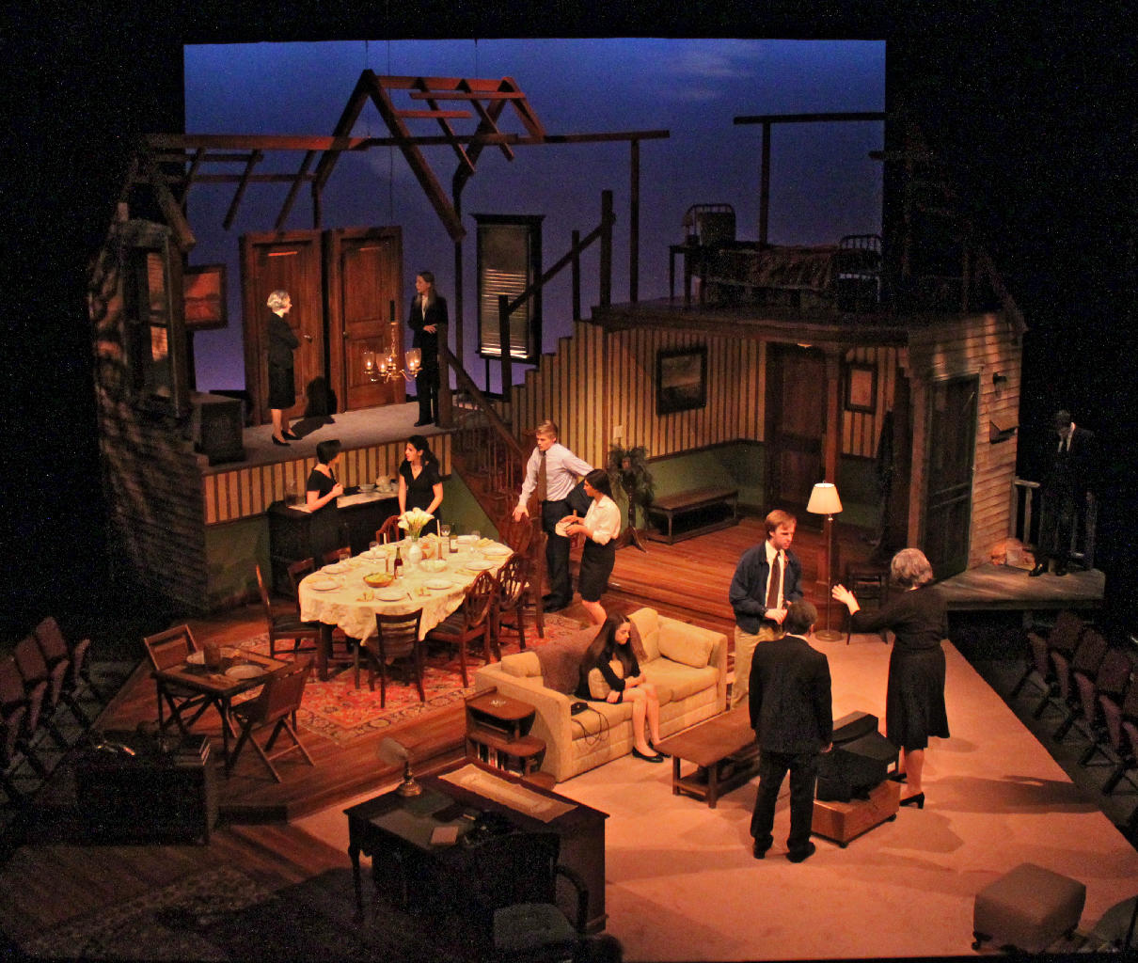
Arthur Miller Theater production
Performed in April 2013
Michigan
Simplest stage design
Open stage design
Close audience proximity
Technically three stories
Set design by Eli Schlatter

Slide 6
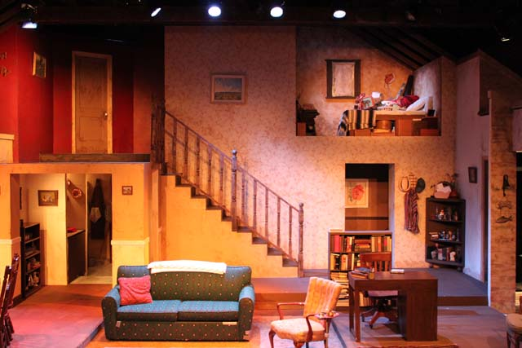
Keegan Theatre’s production
Performed in September 2011
Washington D.C
Two story set design
Limited stage space
Enclosed doll house like stage design.
Stage design by DBMC Architecture

Slide 8
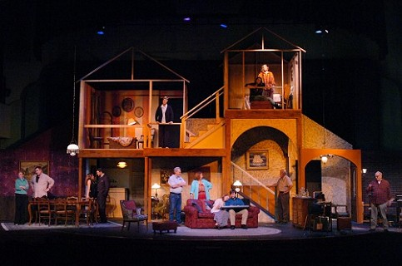
Denton Community Theater production
Performed in September 2013
Texas
Closed stage design
Limited stage space
Three story house
More of an open stage concept
Stage design by Mike Strecher

Slide 10
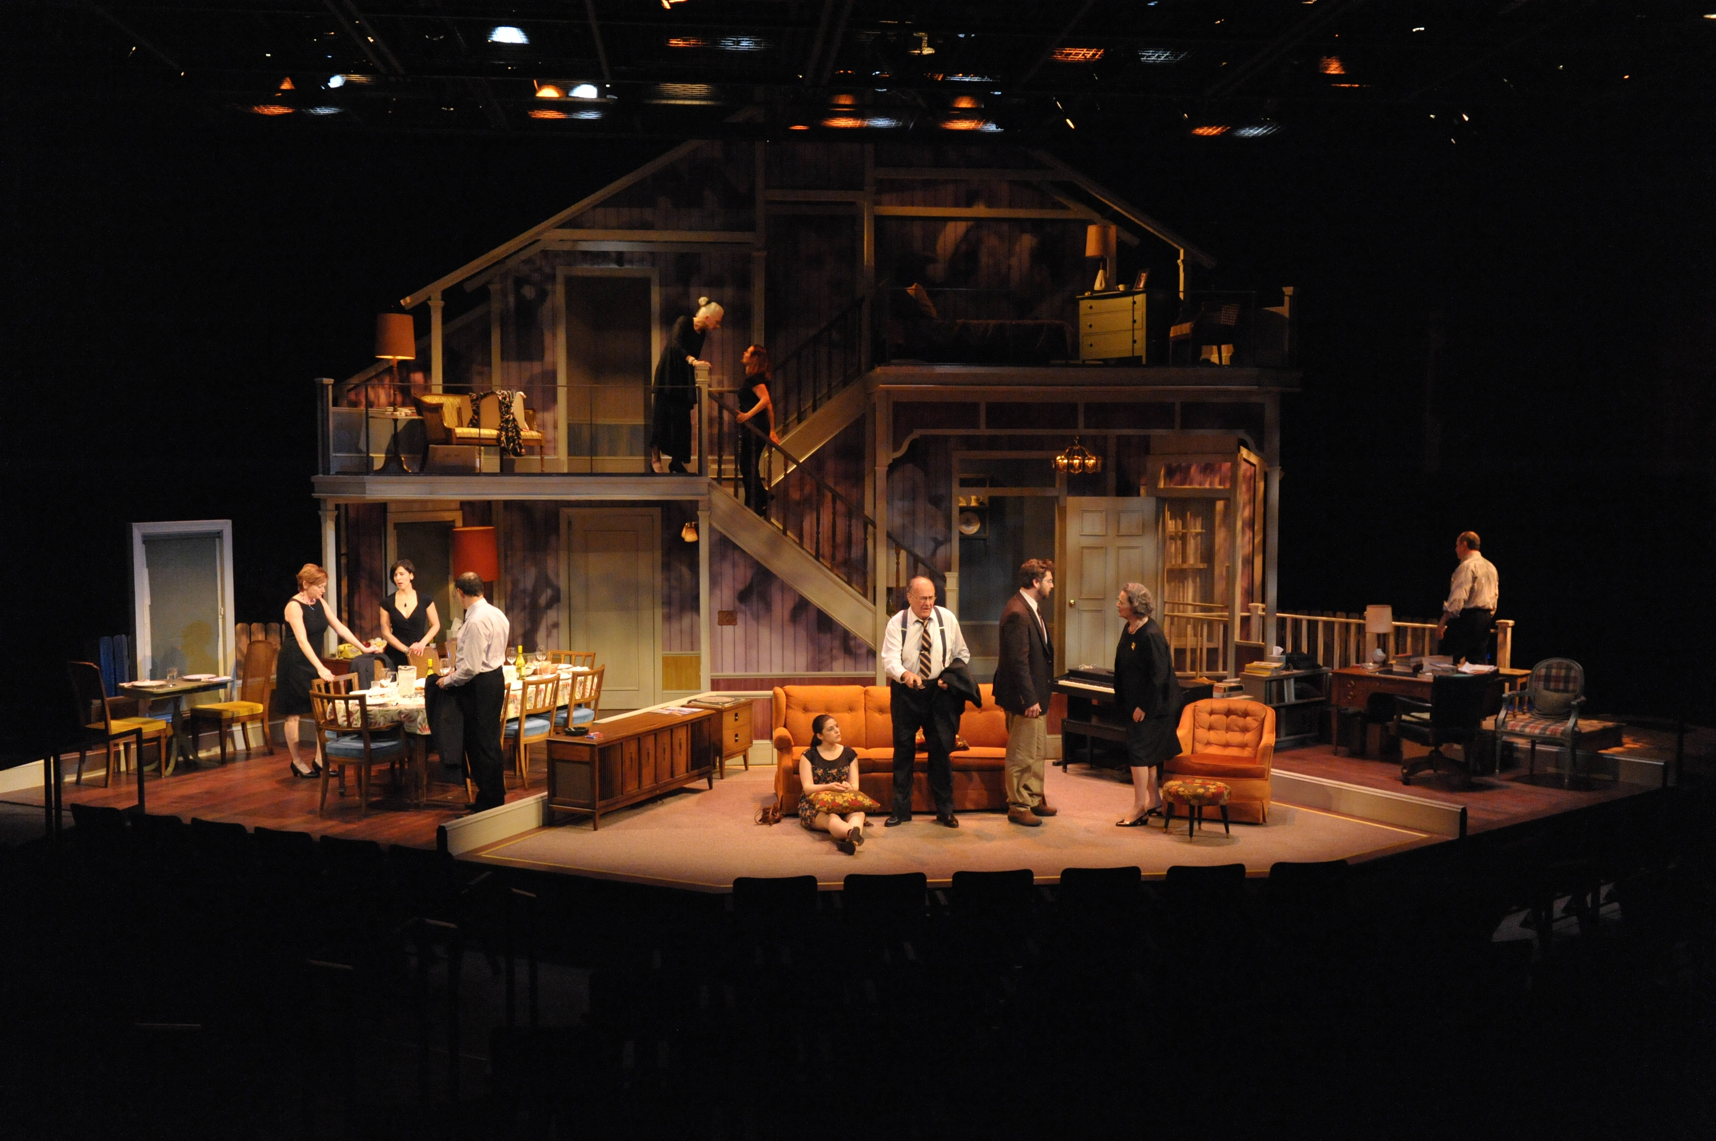
Everyman Theater production
Performed in February 2013
Maryland
Wrap around stage
Three story house
Open Stage layout
Darker coloring
Limited by stage size
Stage design by Daniel Ettinger

Slide 12
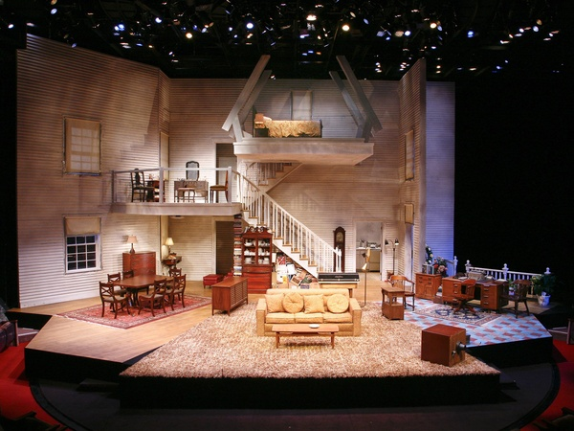
Alley Theater production
Performed in March 2011
Texas
Very open stage design
Light colors used
Three story stage
Wasn’t as limited by stage size
Stage design by Kevin Rigdon

Slide 14
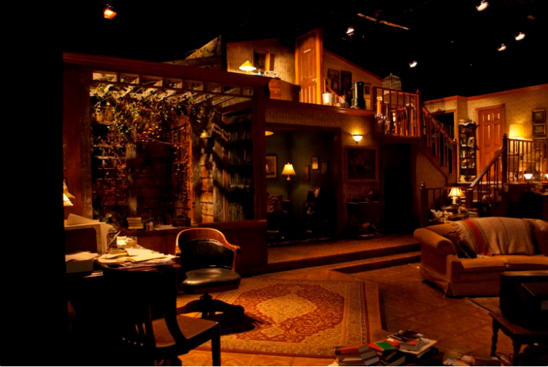
The Warehouse Theater production
Performed in March 2014
South Carolina
Closed stage design
Two story stage design
Darker colors and lighting
Much smaller stage
Stage design by Shannon Robert

Slide 16
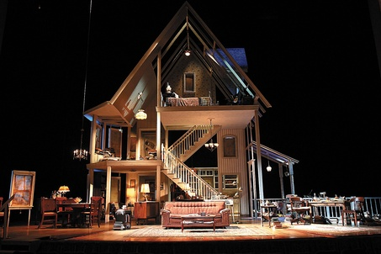
Steppenwolf Theatre Company production
Performed in August 2007
Chicago
First true three story house
Open stage design
Not limited by stage space
Lighter color
One of the most accurate
Stage design by Ann G. Wrightson

Slide 18
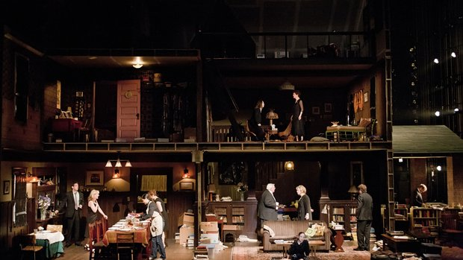
Old Globe theater production
Still preforming
California
Largest stage design
True three story house
A lot of detail and clutter
Darker coloring
Industrial appearance
Stage design by David Zinn

Slide 20
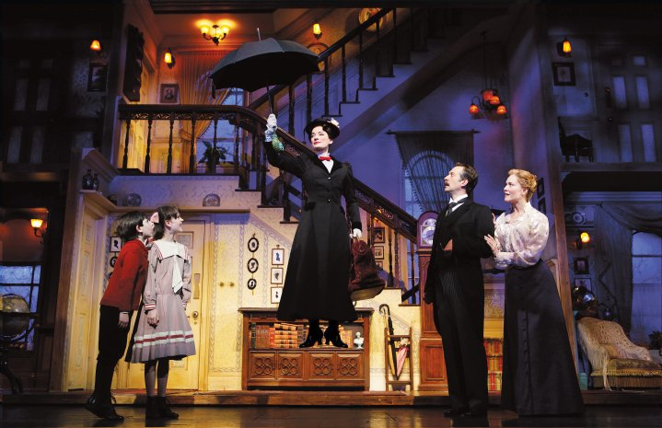
How stage design compares to similar plays
Marry Poppins
Similar technique in stage design
Doll house like stage design
Set was on wheels
Multiple events make this impossible for August: Osage County.
2007 Broadway stage design

